Slide 1
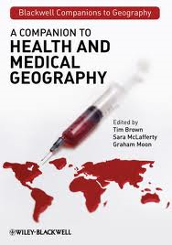
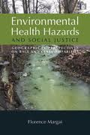
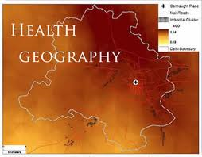
GIS and Health Geography
Perspectives on health geography

Slide 2
Why Geography and Health?
As Dr. Trevor Dummer (2008) stated: Geography and health are intrinsically linked. Where we are born, live, study and work directly influences our health experiences: the air we breathe, the food we eat, the viruses we are exposed to and the health services we can access. The social, built and natural environments affect our health and well-being in ways that are directly relevant to health policy. Spatial location (the geographic context of places and the connectedness between places) plays a major role in shaping environmental risks as well as many other health effects.
(CMAJ April 22, 2008 vol. 178 no. 9)
Notes:
http://www.cmaj.ca/content/178/9/1177.full

Slide 3
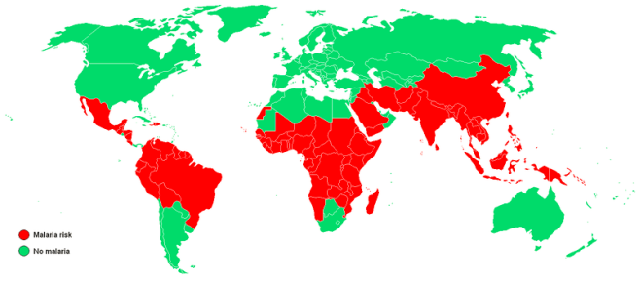
Geography and health
Early studies identified the differences in diseases experienced by people living at high versus low elevation. It was easily understood that those at living low elevations near waterways would be more prone to malaria than those at higher elevations or in drier, less humid areas. Though the reasons for these variations were not fully understood at the time, the study of this spatial distribution of disease is the beginnings of medical geography. (From About.com’s description of Medical Geography)
Notes:
http://geography.about.com/od/culturalgeography/a/medicalgeograph.htm
This field of geography did not gain prominence until the mid-1800s though when cholera gripped London. As more and more people became ill, they believed they were becoming infected by vapors escaping the ground. John Snow, a doctor in London, believed that if he could isolate the source of the toxins infecting the population they and cholera could be contained.
As part of his study, Snow plotted the distribution of deaths throughout London on a map. After examining these locations, he found a cluster of unusually high deaths near a water pump on Broad Street. He then concluded that the water coming from this pump was the reason people were becoming sick and he had authorities remove the handle to the pump. Once people then stopped drinking the water, the number of cholera deaths dramatically decreased.
Snow’s use of mapping to find the source of disease is the earliest and most famous example of medical geography. Since he conducted his research however, geographic techniques have found their place in a number of other medical applications.
Another example of geography aiding medicine occurred in the early 20th Century in Colorado. There, dentists noticed that children living in certain areas had fewer cavities. After plotting these locations on a map and comparing them with chemicals found in the groundwater, they concluded that the children with fewer cavities were clustered around areas that had high levels of fluoride. From there, the use of fluoride gained prominence in dentistry.
http://en.wikipedia.org/wiki/File:Malaria_map.PNG

Slide 4
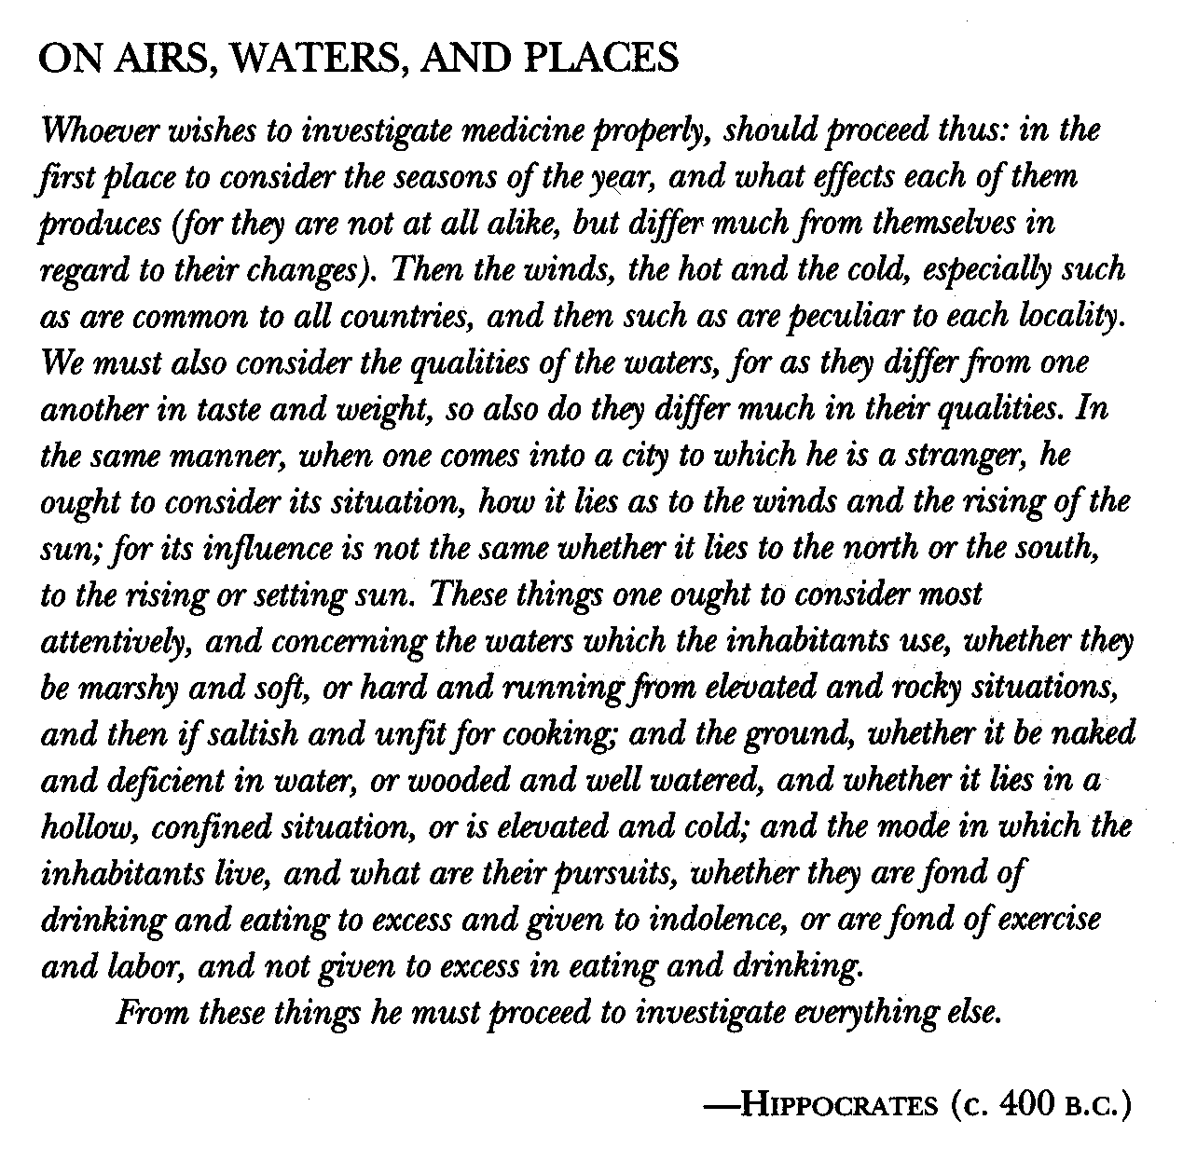

Slide 5
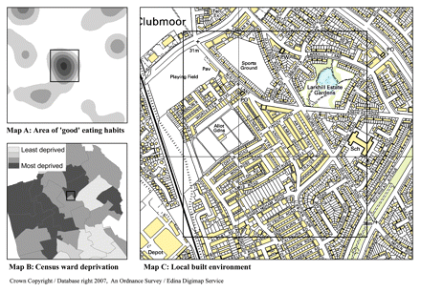
Geography and health
Exploratory spatial analysis of children's eating habits in Liverpool, United Kingdom. The use of a geographic approach for analyzing, mapping and integrating different data sets allows data to be explored in a novel way.
Notes:
http://www.cmaj.ca/content/178/9/1177.full Exploratory spatial analysis of children's eating habits in Liverpool, United Kingdom. Data on individual children's food choices in Liverpool were mapped to identify areas of good eating habits (darker shaded areas in Map A). A small area of good eating habits (boxed area in Map A) is located in a community that crosses 2 census wards (Map B). One of these wards has a very high level of socio-economic deprivation and poverty (Map B). However, Map C shows that, despite the high level of deprivation, the local built environment contains many open spaces, parks, recreation facilities and allotment gardens for growing fruit and vegetables, and these factors are potentially associated with children making better diet choices. The use of a geographic approach for analyzing, mapping and integrating different data sets allows data to be explored in a novel way. Although this is an exploratory method, it provides some hypotheses, such as the role of the built environment in influencing food choices, that can be analytically tested and that can provide suggestions for policies that might help tackle obesity problems.

Slide 6
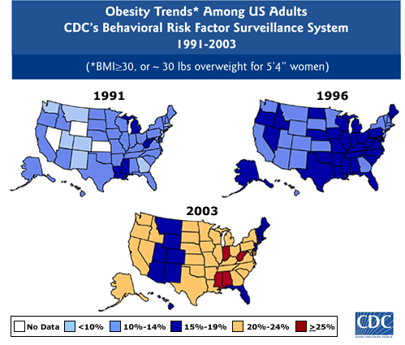
Geography and health
Notes:
http://www.getamericafit.org/statistics-obesity-in-america.html

Slide 7
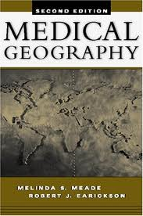
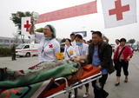
Medical Geography
In order to understand health geography we should first consider the past, when medical geography was the norm.
Some definitions of medical geography:
Medical geography is the application of geographical perspectives and methods to the study of health, disease and health care.
Johnston et al., (1994) Dictionary of Human Geography, p.374.

Slide 8
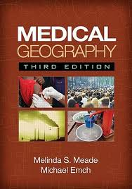
Medical Geography
Medical geography uses the concepts and techniques of the discipline of geography to investigate health-related topics.
Subjects are viewed in holistic terms within a variety of cultural systems and a diverse biosphere. Drawing freely from the facts, concepts and techniques of other social, physical, and biological sciences, medical geography is an integrative, multi-stranded subdiscipline that has room within its broad scope for a wide range of specialist contributions.
Mead and Earickson (2000) Medical Geography, p.1

Slide 9
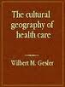
Health Geography
The new generation of health geographers, in reaction to the previous medical geographer's view of the discipline, state:
Our reply is that this dominant ‘biomedical’ viewpoint is both flawed and limited.
There is an urgent need to ‘go outside the body,’ to develop an alternative social and environmental perspective on health in which geography can play an important part, along with other social sciences.
Jones and Moon (1989) Health, Disease and Society: An Introduction to Medical Geography, p 1.

Slide 10

Health Geography
Local variations in health status and health care provision are certainly important, but the principal concerns of medical geography as currently practised--access to and the location of and utilisation of health facilities, the use of quantitative techniques for spatial analysis in health care planning, or the socio-political determinants of health and access to health care--are limiting. Medical geography requires radical surgery if it is truly to come to grips with such issues.
Mohan (1989) Medical geography: Competing diagnoses and prescriptions, Antipode21(2), p. 176.

Slide 11

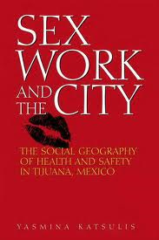
Health Geography
In the marriage of humanistic geography and contemporary models of health suggested by these writers, we have an incipient “post-medical” geography of health.
Kearns (1993) Place and health: Towards a reformed Medical Geography, Professional Geographer, 45(2): p 141

Slide 12
Perspectives
In so far as it is possible to distinguish clearly between the areas of work labeled ‘traditional’ and ‘contemporary’, we suggest that the ‘traditional’ strands accept disease as a naturally occurring, culture-free, and ‘real’ entity, where the problems posed by questions of accurate measurement and distribution are assumed to be technical and solvable.
In contrast, the other ‘contemporary’ strands adopt a stance which argues, in various ways, that notions of health, disease, and illness are problematic, and intimately linked to power relations in society. Thus, the assumption of health professionals as invariably caring, neutral scientists is questioned, and the different roles they fulfill in maintaining the current social order become subjects for scrutiny.
Curtis and Taket (1996) Health and Societies, p. 22.

Slide 13
Perspectives
Robin Kearns (1993) suggested: ‘Rather than advocating a renaming of medical geography, I suggest that two interrelated streams be identified within the medicine/health/geography nexus: medical geography and the geography of health. The concerns of the former are well known and involve spatial and ecological perspectives on disease and health care delivery. The concerns of the latter would consider the dynamic relationship between health and place and the impacts of both health services and the health of population groups on the vitality of places'. (Professional Geographer 45(2), 144-5)

Slide 14

Perspectives
Five Strands of Health Geography
Spatial patterning of disease and health
Spatial patterning of service provision
Humanistic approaches to ‘medical geography’
Structuralist / materialist / critical approaches to ‘medical geography’
Cultural approaches to ‘medical geography’
Notes:
Although health geography is closely aligned with epidemiology, its distinct primary emphasis is on spatial relations and patterns. Whereas epidemiology is predicated on the biomedical model and focuses on the biology of disease, health geography seeks to explore the social, cultural and political contexts for health within a framework of spatial organization. Traditionally, research in health geography spans 2 distinct avenues: the patterns, causes and spread of disease, and the planning and provision of health services. Research in these interlinked areas supports policy development. For example, disease epidemiology is in part related to the geography of health service provision. Dr. Trevor Dummer, IWK Health Centre, Goldbloom RCC Pavilion, 5850/5980 University Ave., PO Box 9700, Halifax NS B3K 6R8; CMAJ April 22, 2008 vol. 178 no. 9 doi: 10.1503/cmaj.071783 http://www.cmaj.ca/content/178/9/1177.full

Slide 15

Perspectives
Spatial patterning of disease and health
Approaches
Patterns of disease + patterns of topography, meteorology
Medical cartography (e.g. mortality atlases)
Early work actually conducted by physicians (Snow, 1855)
Diffusion
Quantitative
Assumptions
Diseases = ‘facts’
Role = understand ecology of diseases (Jacques May, 1958 – ‘father’ of medical geography)
Examples: cholera in Soho London - 1854 (Snow); malaria
Limitations: Ecological fallacy = main analytical enemy

Slide 16
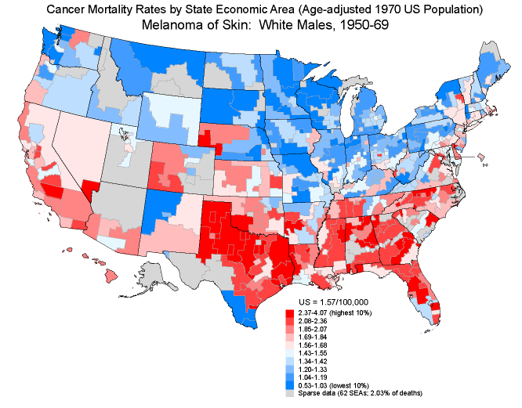
US Cancer Atlas
http://www3.cancer.gov/atlasplus/
Notes:
During both time periods, a north-south differential was seen among white males and females, with lower rates in the North and higher rates in the southeastern and south-central regions. The low rates in south Texas and south Florida may be due to the concentration of Hispanic populations, which have low rates of melanoma. (37) The persistent latitudinal gradient seen for melanoma has been attributed to ultraviolet radiation from sunlight, especially when exposures occur at young ages. The epidemiologic patterns for melanoma suggest that intermittent or recreational exposures are especially important, along with host usceptibility factors, including light skin pigmentation and dysplastic nevi. (90) Because of the rarity of melanoma among blacks, the data were too sparse for mapping. http://dceg.cancer.gov/atlas/text2/full_txt.html#disc-liv

Slide 17
Perspectives
Spatial patterning of service provision
Approaches
Spatial patterns of health service facilities (mainly hospitals)
Patterns of utilization
Patterns of inequity in supply and use (demand) of services
Quantitative
Assumptions
Disease = ‘fact’
People are ‘optimizers’ - re: rationality
Health care = major determinant of ‘health’
Distance decay
‘Build it, and they will come.’
Examples: optimal ambulance shed locations - location/allocation models; spatial patterns of childhood immunization
Notes:
If one is an optimizer, one chooses an alternative that ranks at least as high as any other. In contrast, if one is a satisficer, one settles for any alternative one considers satisfactory. Unlike the optimizer, who stops searching when she has either considered all her options or has run up against things like time constraints, the satisficer stops the search upon identifying an alternative as good enough.

Slide 18
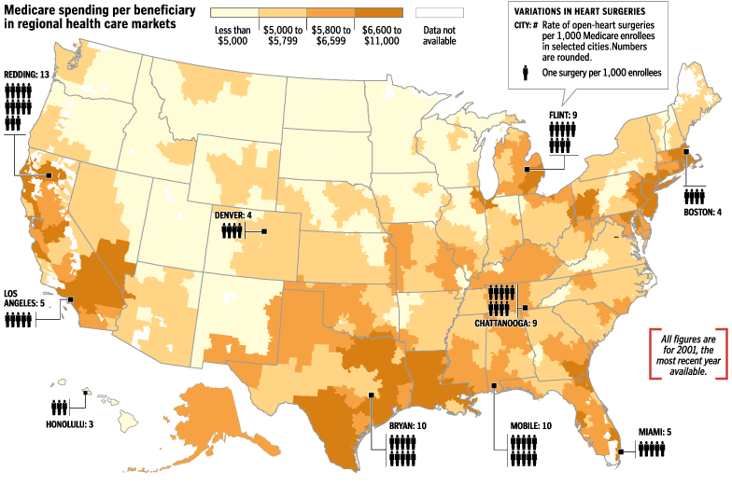
Patterns of utilization
Notes:
Medicare spending varies widely from state to state, often even in neighboring Zip codes, after adjusting for regional differences in prices, age or other population factors. Experts say that spending tends to be higher in areas where there are more doctors, more hospitals, more technology and a culture that encourages more medical interventions. The chances that a patient will have certain surgeries, such as an open-heart operation, also fluctuate with geography. http://www.washingtonpost.com/wp-dyn/content/graphic/2005/07/23/GR2005072300362.html

Slide 19
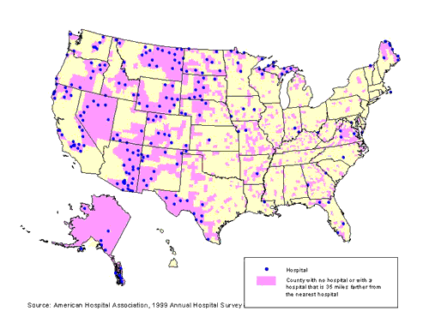
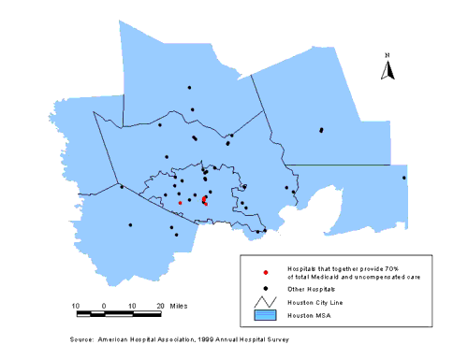
Health care service provision
http://www.esri.com/news/arcuser/0702/healthtrends2of2.html
Notes:
The map on the left shows all counties without a hospital or having a hospital greater than 35 minutes away (assumed max time for emergency transport). Houston, shown in the figure on the right, has 51 hospitals. The only public hospital in the area provides 36 percent of the area's Medicaid and uncompensated care. In addition, five hospitals combine to provide 70 percent of care to the uninsured.

Slide 20
Perspectives
Humanistic approaches to ‘medical geography’
Approaches
Understand lay rationality
Qualitative - e.g., grounded theory, phenomenology
Assumptions
Illness = socially constructed
People are ‘satisficers’ - re: rationality
Perception of health = major determinant of ‘health’
Social context influences perception
Meaning can be understood from stories
Examples: lay perceptions of health (Eyles and Donnovan 1986); impact of environmental policy on the health of communities
Limitations: what about social constraints on human action?
Notes:
The lay perspective emphasizes a definite split between lay and expert views on the value and quality of pharmaceuticals, drug therapy and pharmacy services, as well as in their assessment of risk. Participants voiced spontaneous criticism of the roles of both physicians and pharmacists in drug therapy; and expressed concern about the quality and safety of pharmaceuticals. Ignorance of health issues was seen to be a particular characteristic of the lower socioeconomic groups, and was considered to be an important obstacle to health education programmes.
Whether or not, when allowing for a plant to open that would process toxic wastes, the concerns of the people about the effects on their health should be given equal weight to the economic concerns.

Slide 21
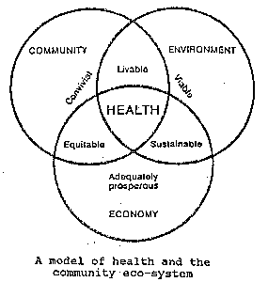
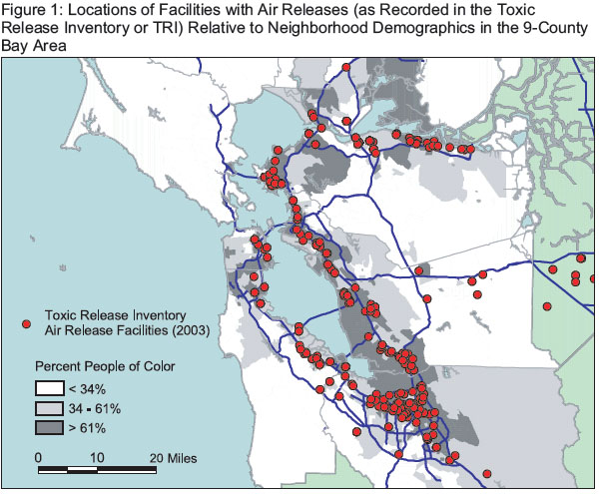
Environmental justice
http://msucares.com/health/health/appa1.htm
http://leftinsf.com/blog/index.php/archives/1672

Slide 22
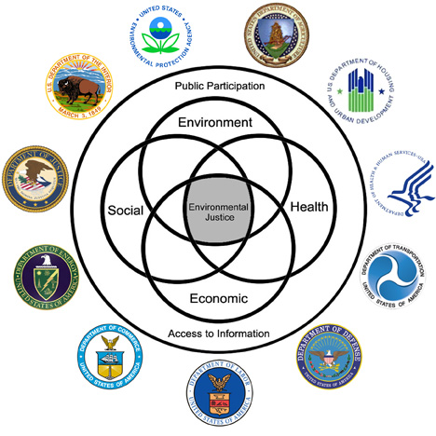
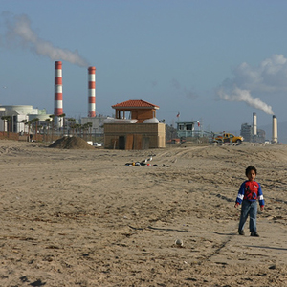

Environmental justice
USA EPA
Notes:
http://www.epa.gov/Compliance/environmentaljustice/interagency/ http://www.njeja.org/

Slide 23

Perspectives
Structuralist / materialist / critical approaches to ‘medical geography’
Approaches
Inequalities in health
Marxist critiques of capitalism
Assumptions
Structure of social/political/economic system is the key determinant of health and variation in health
Macro-scale analysis is important
Understand links between h/c professionals and reproduction of unequal power relations
Examples: community-based childcare; health inequalities in Canada
Limitations: what about human agency/creativity to overcome social constraints?
Notes:
‘‘medical issues are a necessary, but insufficient, focus in developing cultural geographies of health and healing. Putting gender, ‘race’, disability and sexual orientation onto the agenda will provide an opportunity to understand difference and resistance to medical models of health.’’ (Gesler & Kearns, (2002). p. 7)

Slide 24

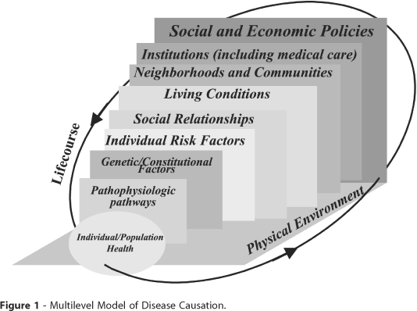
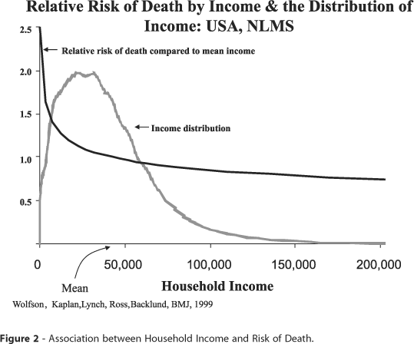

Socio-economic factors
http://www.scielosp.org/scielo.php?script=sci_arttext&pid=S1415-790X2002000400004&nrm=iso&tlng=pt
Notes:
socioeconomic factors put more than the very poor at a health disadvantage, a relatively uncritical examination of the shape of this gradient and/or data limitations has tended to leave the reader with a feeling that the relationship between socioeconomic position and risk of poor health or death is linear. The reality is very far from that - at least with respect to the relationship between household income and risk of death. The right figure shows how decidedly non-linear the relationship is when examined using the National Longitudinal Mortality Study, a cohort of over one million people whose mortality experience was prospectively examined over almost a decade. As can be seen, the increased risk associated with income differences is greatest among the bottom third of the income distribution and diminishes rapidly with increasing income after that point.

Slide 25
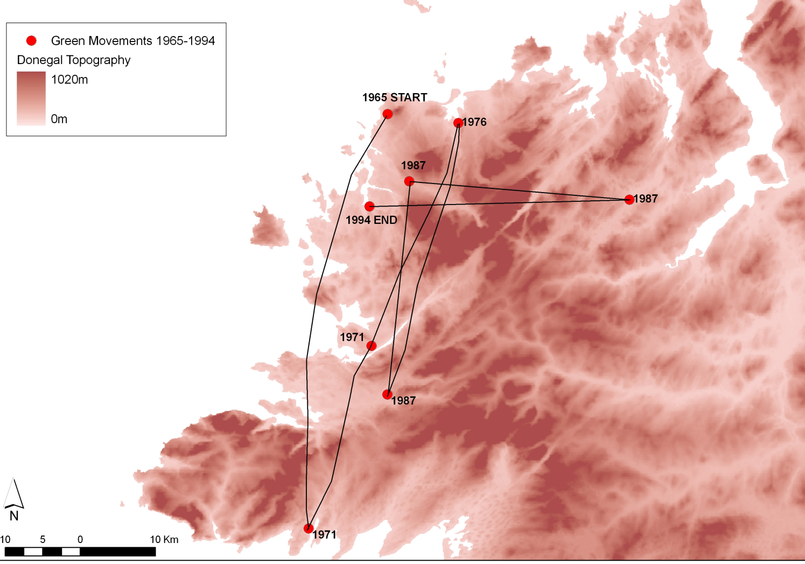
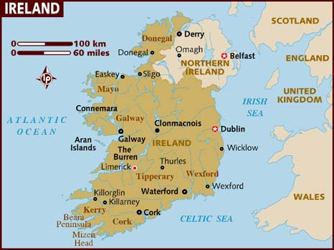
Notes:
Fr. Green, whose thirty-year reign of terror saw him regularly moved to new locations throughout his career. Staggeringly, these nodes on a spatial network were all found within a single Irish County, Donegal, as was graphically portrayed in RTE’s Prime Time on November 26th and which is redrawn below. http://nuimgeography.wordpress.com/category/health-geography/
This also relates to social constraints on human action present in the Humanistic view of health geography.

Slide 26

Perspectives
Cultural approaches to ‘medical geography’
Approaches
Therapeutic landscapes
Health promotion
Assumptions
Reframe health in positive terms
‘Place’ important determinant of health
Examples: Hokianga district New Zealand - rural health centres (Kearns, 1993); culturally sensitive health promotion (Manson-Singer et al., 1996)
Limitations: what about social constraints on human action?
http://www.ingentaconnect.com/content/els/13538292/1998/00000004/00000004/art00033
Notes:
An analysis of these narratives revealed that, consistent with socioeconomic limitations, concerns over exposing ones body loomed large in women’s reasons for delaying obtaining a PAP smear to test for cervical cancer. In particular, feelings of shyness and embarrassment were encountered among Maori and Pacific women for whom exposing their bodies in the process of smear taking compromises cultural beliefs about sacredness. Medical geography is therefore moving beyond its ethnocentric foundations to highlight the variability of meanings, cultural practices and material conditions shaping people's relationships to disease, illness, health and medicine. In particular, Gesler (1991) has advocated studies of `folk' medicine because it serves the majority of people in developing countries: ``If social scientists are really interested in the health of all the world's inhabitants, then they must study non-professional traditional healing. . .research is trickling in but there is not nearly enough'‘ The aims of the paper are three fold: first, to advance the debate surrounding the conceptualisation of medicine and health through examination of literature on African medicinal systems; secondly, to examine in detail the health care system of the Jola of The Gambia, documenting indigenous human and ethnoveterinary medical beliefs and practices and focusing in particular on the role of herbal medicine; thirdly, to discuss the interactions and links between indigenous medicine and biomedicine, thus demonstrating the importance of placing an understanding of health care systems in different places within an awareness of global power relations. (Therapeutic landscapes paper)

Slide 27
The differences
The discipline has traditionally been divided into two fairly distinct subjects: one examines the geographical factors which contribute to ill-health and disease (geographical epidemiology); whereas the other deals with geographical factors influencing the provision of and access to health services (geography of health care).

Slide 28

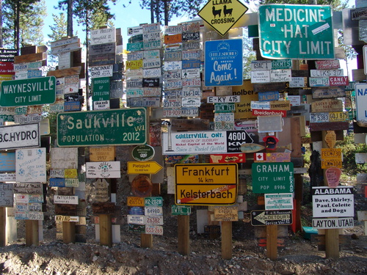
The differences
Place versus space. Health geographers put the emphasis on place as opposed to space – that is, the unique characteristics of particular places as opposed to spatial variations and relationships.
Geographical scale. There is a tendency for health geographers to focus on the relationship between people and their local contexts, as opposed to variations between places at a regional, national, or even international level.

Slide 29

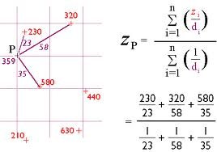
The differences
Qualitative versus quantitative research methodologies. ‘Pure’ health geographers tend to favour qualitative methodologies (e.g. in-depth interviews) as opposed to quantitative methodologies (e.g. statistical analysis of mortality or morbidity data).
The centrality of social theory. Health geographers tend to be firmly rooted within social theory, whereas more traditional medical geographers tend to be more eclectic.

Slide 30
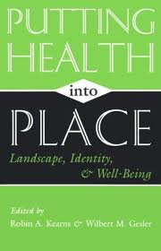
The similarities
Geographic research in health is often dichotomized between quantitative and qualitative methodologies, with quantitative studies closely aligned with epidemiology and qualitative studies aligned with medical sociology and social sciences. Although differences in approach are important for the assessment of complex problems, these methodologies share a common theme: the role of place and space in health.
Notes:
http://www.cmaj.ca/content/178/9/1177.full

Slide 31
The similarities
For example, a quantitative study of an outbreak of an infectious disease such as mumps might focus on spatial modelling of disease diffusion, whereas a qualitative investigation might focus on socio-cultural influences on vaccination uptake within communities, the characteristics of which have been defined within an epidemiology–health geography framework. Often, health geographers will combine quantitative and qualitative methods in complimentary mixed-methods approaches. Geographers contribute to methodological developments that are useful in health research, including multi-level statistical models, cluster analysis and geographically weighted regression analysis
Notes:
http://www.cmaj.ca/content/178/9/1177.full

Slide 32
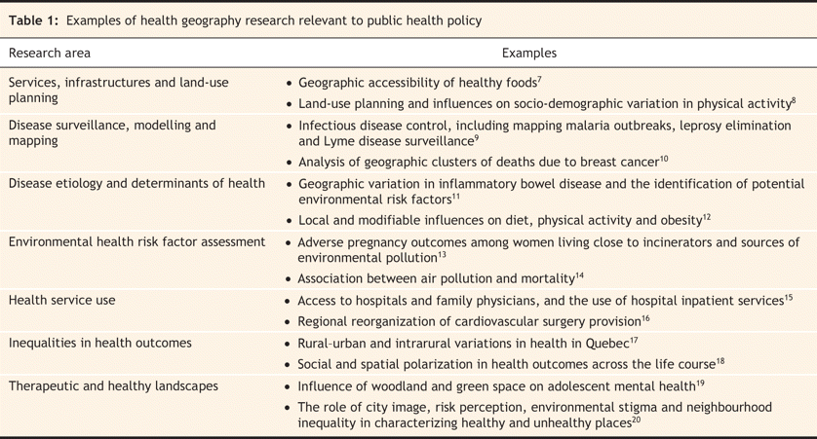
Examples of Health Geography Studies
Dr. Trevor Dummer, CMAJ April 22, 2008 vol. 178 no. 9
Notes:
http://www.cmaj.ca/content/178/9/1177/T1.medium.gif

Slide 33


Health Geography
Conclusion
‘medical geography’ = too narrow for some – ‘health geography’ preferred
Now, much more in tune with debates in social theory and policy
Special role for ‘place’ - physical space, place in the world, sense of place, cultural space
Notes:
The eleventh International Medical Geography Symposium brought together, in Fort Worth, Texas, in early July, 2005, some 140 professionals who engage in, either directly, or indirectly, medical/health geography. Some interesting developments spring to mind. In the 36-paper titles from these symposia in 1986 and 1988, the word ‘‘inequality’’ was not to be found. The odds now seem very low of extracting at random 36 titles from the vitae of health geographers today and finding no allusion to inequality. Consider also that in the same list of titles from the earlier epoch, the word ‘‘environment’’ was virtually absent. Today, environmental health is a hot topic in the discipline. Liz Twigg’s exploratory article on geographical information systems (GIS) in 1988 (an examination of the potential for health based GIS) was a harbinger of what we now observe on a daily basis in health geography (Twigg, 1990). Today, one can scarcely find an undergraduate in the USA going into health geography without at least one course in GIS on their transcript. In both of the earlier symposia, there may have been one or two papers in which qualitative analysis was undertaken; today this method is virtually as mainstream as introductory statistics. But, above all, the profusion of literature by health geographers on culture and critical assessment of resource distribution and environmental contamination, with a concomitant increase in qualitative analysis has redefined the field, at least for the present.

